Slide 1

SELF STUDY PROJECT Under the Guidance of PROF. H.C.Taneja DEPARTMENT OF APPLIED MATHEMATICS DELHI TECHNOLOGICAL UNIVERSITY,DELHI
TIME SERIES Forecasting
Submitted By-
ANKITA PAL

Slide 2
Objective
The objective of this project is to implement various time series models on the given quarterly rainfall dataset over the years 1995-2005 , using MICROSOFT EXCEL and to verify these using and to verify them using ZAITUN TIME SERIES , a software specifically used for time series forecasting.
It also grahically compares the forecast made with the help model with the actual data of next 5 years i.e 2006-2011

Slide 3
What is Forecasting ?
Forecasting is the process of making predictions of certain entities in specified future date based on past and present data and analysis of trends
Common example of forecasting are
Annual rainfall
Weather forecasting,
Market demand of any product
Life expectancy
etc

Slide 4
Why is forecasting important ?
Forecasting of natural calamity like draught, flooding, epidemic( like dengue) in a state / country well in advance allows the Govt./ Planner/Agencies to take the measures to minimize the impact in form of loss of life , property.
Forecasting is of utmost importance in setting up a new business or running a business
Strategic planning (long range planning)
Finance and accounting (budgets and cost controls)
Marketing (future sales, new products)
Production and operations

Slide 5
Types of forecasting
Qualitative forecasting:
These techniques are subjective , based on the opinion and judgment of consumers ,experts: appropriate when past data is not available. It is usually applied to intermediate-long range decisions.
Quantitative forecasting:
They are used to estimate future demands as a function of past data; appropriate when past data is available. It is usually applied to short-intermediate decisions

Slide 6
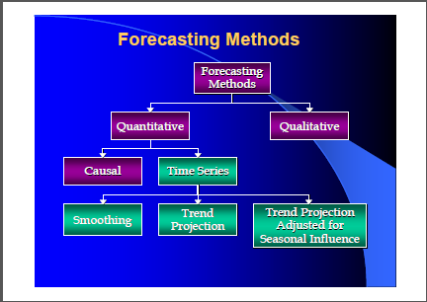
Forecasting
Rely on data and analytical techniques
Rely on subjective opinions from one or more experts.

Slide 7
Introduction to Time Series Analysis
A time-series is a set of observations on a quantitative variable collected over time.
Examples
Dow Jones Industrial Averages
Historical data on sales, inventory, customer counts, interest rates, costs, etc
Annual rainfall.(click here to view in excel)
Businesses are often very interested in forecasting time series variables.
Often, independent variables are not available to build a regression model of a time series variable.
In time series analysis, we analyze the past behavior of a variable in order to predict its future behavior.

Slide 8
Some Time Series Terms
Stationary Data - a time series variable exhibiting no significant upward or downward trend over time
Nonstationary Data - a time series variable exhibiting a significant upward or downward trend over time
Seasonal Data - a time series variable exhibiting a repeating patterns at regular intervals over time
Random Data - a time series variable without any describable pattern

Slide 9
Components Of A Time Series
Any time series can contain some or all of the following components:
1. Trend (T)
2. Cyclical (C)
3. Seasonal (S)
4. Irregular (I)
These components may be combined in different ways. It is usually assumed that they are multiplied or added, i.e.,
yt = T × C × S × I
yt = T + C + S + I
To correct for the trend in the first case one divides the first expression by the trend (T). In the second case it is subtracted.

Slide 10
Components Of A Time Series
Trend component:
The secular trend is the main component of a time series which results from long term effect of socio-economics and political factors. This trend may show the growth or decline in a time series over a long period. This is the type of tendency which continues to persist for a very long period. Prices, export and imports data, for example, reflect obviously increasing tendencies over time.
Cyclical component
Any pattern showing an up and down movement around a given trend is identified as a cyclical pattern. The duration of a cycle depends on the type of business or industry being analyzed.
Seasonal component
Seasonality occurs when the time series exhibits regular fluctuations during the same month (or months) every year, or during the same quarter every year. For instance, retail sales peak during the month of December.
Irregular component
This component is unpredictable. Every time series has some unpredictable component that makes it a random variable. In prediction, the objective is to “model” all the components to the point that the only component that remains unexplained is the random component.

Slide 11
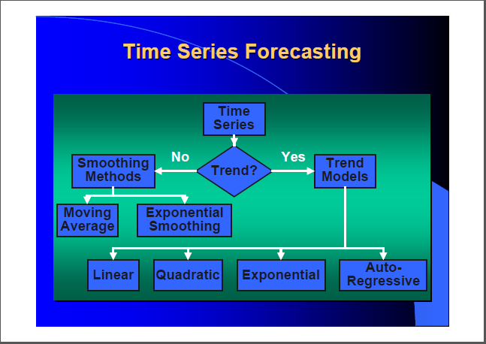
Time series Forecasting methods

Slide 12
Approaching Time Series Analysis
There are many, many different time series techniques.
It is usually impossible to know which technique will be best for a particular data set.
It is customary to try out several different techniques and select the one that seems to work best.
To be an effective time series modeler, you need to keep several time series techniques in your “tool box.”

Slide 13
Measuring Accuracy
We need a way to compare different time series techniques for a given data set. Four common techniques are the:
Mean absolute deviation,
Mean absolute percent error,
Mean square error,
Root mean square error.
Running sum of forecasting errors
Tracking signal

Slide 14
A Comment on Comparing MSE,MAD and TS Values
Care should be taken when comparing MSE values of two different forecasting techniques.
The lowest MSE may result from a technique that fits older values very well but fits recent values poorly.
It is sometimes wise to compute the MSE using only the most recent values.
The tracking signal is a measure of how often our estimations have been above or below the actual value. It is used to decide when to re-evaluate using a model.
Positive tracking signal: most of the time actual values are above our forecasted values
Negative tracking signal: most of the time actual values are below our forecasted values
If TS > 4 or < -4, investigate!
The mean deviation is the first measure of dispersion. It is the average of absolute differences between each value in a set of value, and the average of all the values of that set
Keep in mind that judging the dependability of forecasts isn’t always about minimizing MAD. MAD, after all, is an average of deviations

Slide 15
Smoothing Methods
In cases in which the time series is fairly stable and has no significant trend, seasonal, or cyclical effects, one can use smoothing methods to average out the irregular component of the time series
The exponential moving average (EMA) gives a higher weighting to recent prices than the simple moving average (SMA) does, while the SMA assigns equal weighting to all values. The two averages are similar because they are interpreted in the same manner and are both commonly used by technical traders to smooth out price fluctuations.
The SMA is the most common type of average used by technical analysts

Slide 16
Moving Averages
The moving averages method consists of computing an average of the most recent n data values for the series and using this average for forecasting the value of the time series for the next period. (most recent data values)
Moving Average =
No general method exists for determining k
We must try out several k values to see what works best.
There are several moving average models that can be used in contract pricing. The two most commonly used are the single moving average and the double moving average. Your decision on which model to use will depend on whether the data indicate a trend (upward or downward) in the values of the dependent variable. If there is:
• No time-series data trend - use a single moving average.
• Time-series data trend - use a double moving average.
EXAMPLE

Slide 17
Weighted Moving Average
The moving average technique assigns equal weight to all previous observations
The weighted moving average technique allows for different weights to be assigned to previous observations.
We must determine values for k and the w_{i}
EXAMPLE

Slide 18
Double Moving Average
where
E_{t} is the expected base level at time period t.
T_{t} is the expected trend at time period t.
Example

Slide 19
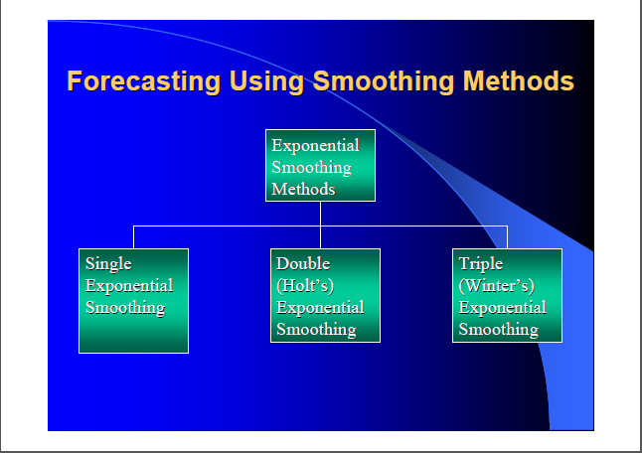
Exponential Smoothing

Slide 20
Single Exponential Smoothing
It can be shown that the above equation is equivalent to:
This method is suitable for forecasting data with no trend or seasonal pattern.
EXAMPLE

Slide 21
Double Exponential Smoothing (Holt’s Method)
where
E_{t} = αY_{t} + (1-α)(E_{t-1}+ T_{t-1})
T_{t} = β(E_{t} −E_{t-1}) + (1-β) T_{t-1}
E_{t} is the expected base level at time period t.
T_{t} is the expected trend at time period t.
This method is used when the data shows a trend. Exponential smoothing with a trend works much like simple smoothing except that two components must be updated each period - level and trend. The level is a smoothed estimate of the value of the data at the end of each period. The trend is a smoothed estimate of average growth at the end of each period
Example

Slide 22
Trend Models
Trend is the long-term sweep or general direction of movement in a time series.
Trend is the component factor of a time series most often used to make intermediate and long-range forecasts

Slide 23
The Linear Trend Model
For example:
Example

Slide 24
The Quadratic Trend Model
Example

Slide 25
Seasonality
Seasonality is a regular, repeating pattern in time series data.
May be additive or multiplicative in nature...
Stationary Seasonal Effects:

Slide 26
Stationary Data With Additive Seasonal Effects
Where,
p represents the number of seasonal periods
E_{t} is the expected level at time period t.
S_{t} is the seasonal factor for time period t.
Example

Slide 27
Stationary Data With Multiplicative Seasonal Effects
where
p represents the number of seasonal periods
E_{t} is the expected level at time period t.
S_{t} is the seasonal factor for time period t.
Example

Slide 28
HOLT WINTERS MODELS
Holt (1957) and Winters (1960) extended Holt’s method to capture seasonality.
The Holt-Winters seasonal method comprises the forecast equation and three smoothing equations — one for the level ℓt, one for trend bt, and one for the seasonal component denoted by st, with smoothing parameters α, β∗ and γ.
We use m to denote the period of the seasonality, i.e., the number of seasons in a year. For example, for quarterly data m=4, and for monthly data m=12.
There are two variations to this method that differ in the nature of the seasonal component.
The additive method is preferred when the seasonal variations are roughly constant through the series, while the multiplicative method is preferred when the seasonal variations are changing proportional to the level of the series. With the additive method, the seasonal component is expressed in absolute terms in the scale of the observed series, and in the level equation the series is seasonally adjusted by subtracting the seasonal component. Within each year the seasonal component will add up to approximately zero.
With the multiplicative method, the seasonal component is expressed in relative terms (percentages) and the series is seasonally adjusted by dividing through by the seasonal component. Within each year, the seasonal component will sum up to approximately m.

Slide 29
Holt-Winter’s Method For=Additive Seasonal Effects
where
EXAMPLE

Slide 30
Holt-Winter’s Method For Multiplicative Seasonal Effects
where
EXAMPLE

Slide 31
Computing Multiplicative Seasonal Indices
We can compute multiplicative seasonal adjustment indices for period p as follows:
The final forecast for period i is then

Slide 32
Summary of the Calculation and Use of Seasonal Indices
1. Create a trend model and calculate the estimated value ( ) for each observation in the sample.
2. For each observation, calculate the ratio of the actual value to the predicted trend value:
(For additive effects, compute the difference:
3. For each season, compute the average of the ratios calculated in step 2. These are the seasonal indices.
4. Multiply any forecast produced by the trend model by the appropriate seasonal index calculated in step 3. (For additive seasonal effects, add the appropriate factor to the forecast.)

Slide 33
Concluusion
The various models explored and implemented on given rainfall data, along with the visual graphs , give us basic understanding of the working and calculations involved in the shaping the model and how the test set responds to the model

Slide 34
THANK YOU

